Slide 1
Quantifying Uncertainty
Course : COMP6065001 Artificial Intelligence
Effective Period : September 2023
Session 07

Slide 2
Learning Outcome
At the end of this session, students will be able to:
LO 3: Apply various techniques to an agent when acting under certainty

Slide 3
Outline
Event, Space
Probability
Conditional probability
Bayes Theorem

Slide 4
Before We Start
Before we start Bayes Theorem, we will review some mathematical concept in Probability.
Event and Sample Space
Probability
Axiom of Probability
Conditional Probability
Bayes Theorem

Slide 5
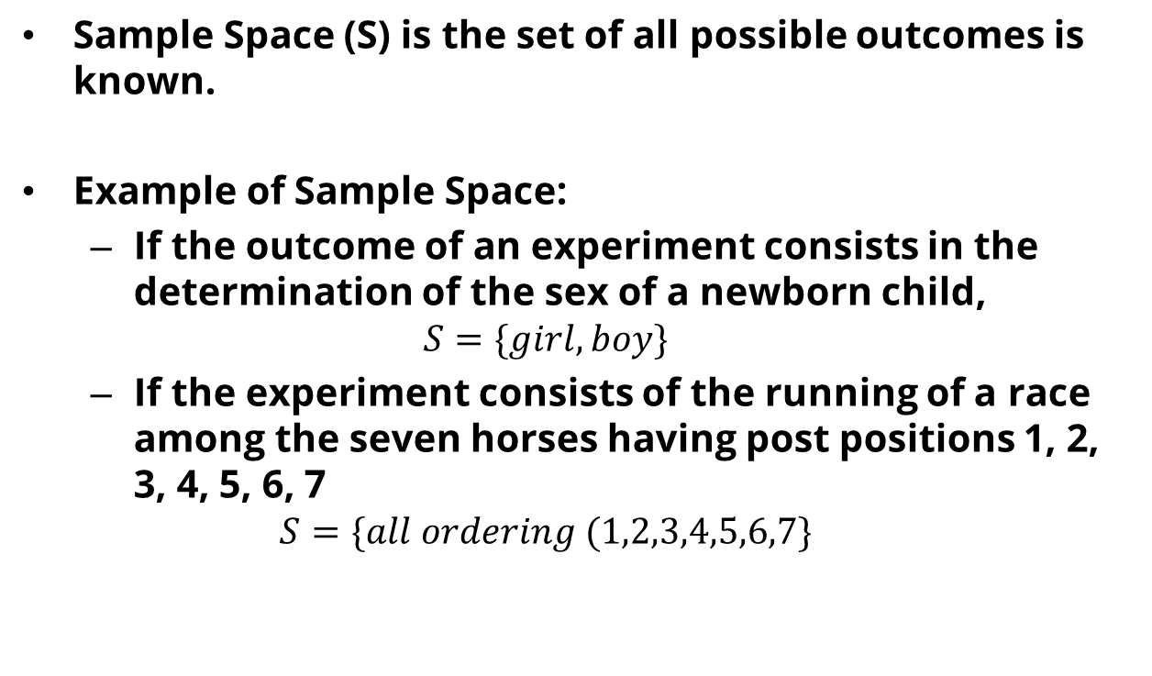
Sample Space
Sample Space (S) is the set of all possible outcomes is known.
Example of Sample Space:
If the outcome of an experiment consists in the determination of the sex of a newborn child,
$$S=\{girl, boy\}$$
If the experiment consists of the running of a race among the seven horses having post positions 1, 2, 3, 4, 5, 6, 7
$$S=\{all ordering (1,2,3,4,5,6,7\}$$

Slide 6
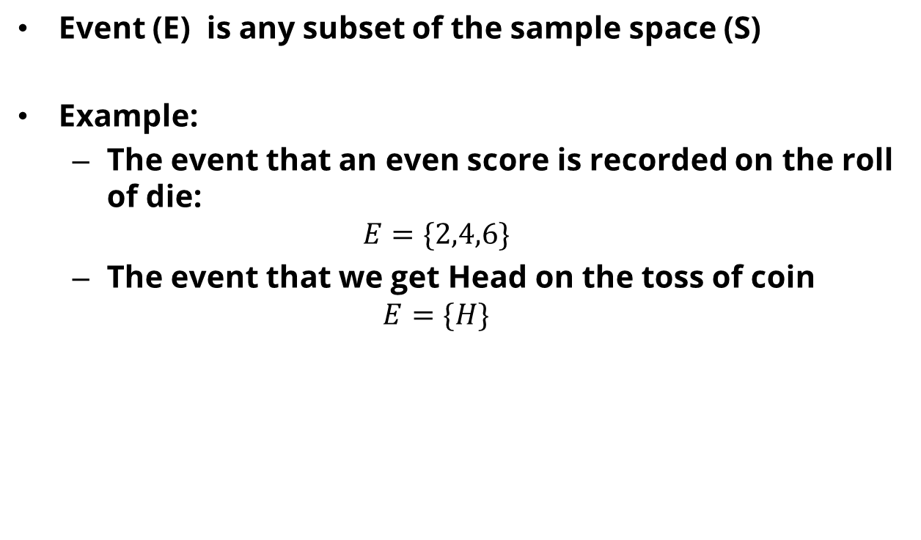
Event
Event (E) is any subset of the sample space (S)
Example:
The event that an even score is recorded on the roll of die:
$$E=\{2,4,6\}$$
The event that we get Head on the toss of coin
$$E=\{H\}$$

Slide 7
Probability
An empirical fact: If an experiment is continually repeated under the exact same conditions, then for any event (E), the proportion of time that (E) occurs approaches some constant value as the number of repetitions increases.
This proportion is called probability of an event (E) is called P(E)

Slide 8
Triggering Question
What is the probability that when I flip a coin it is “heads”?
What is the probability that when I rolled a die it is “3”?

Slide 9

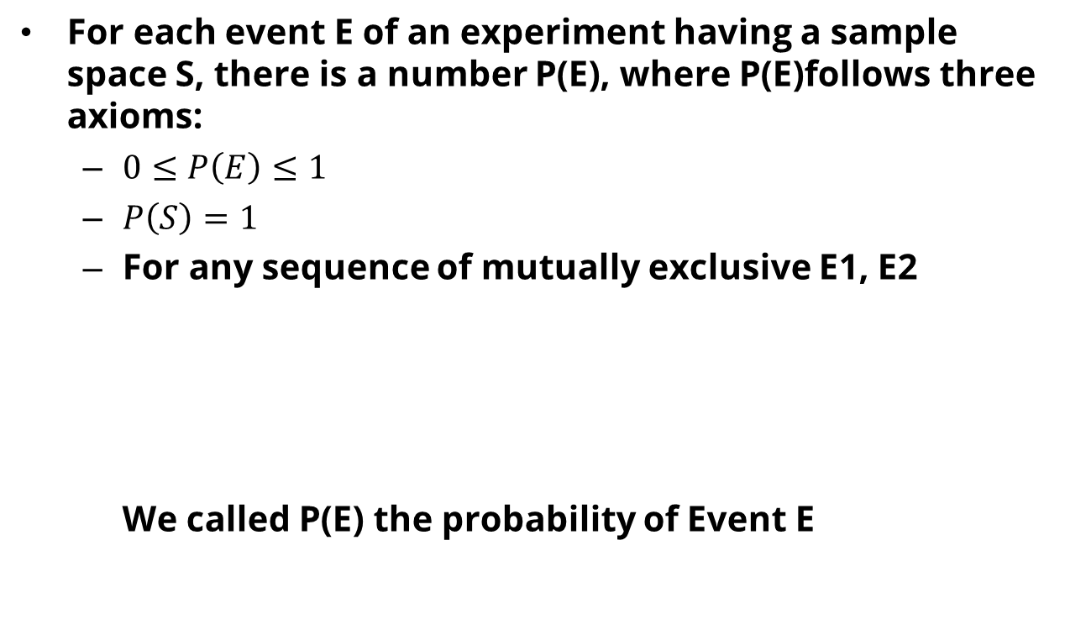
Axiom of Probability
For each event E of an experiment having a sample space S, there is a number P(E), where P(E)follows three axioms:
$0≤P\left(E\right)≤1$
$P\left(S\right)=1$
For any sequence of mutually exclusive E1, E2 We called P(E) the probability of Event E

Slide 10

Axiom of Probability
Proposition 1:
$$1=P\left(S\right)=P\left(E∪E^{c}\right)=P\left(E\right)+P(E^{c})$$
Then
$$P\left(E^{c}\right)=1−P(E)$$
Proposition 2
$$P\left(E∪F\right)=P\left(E\right)+P\left(F\right)−P(E∩F)$$

Slide 11
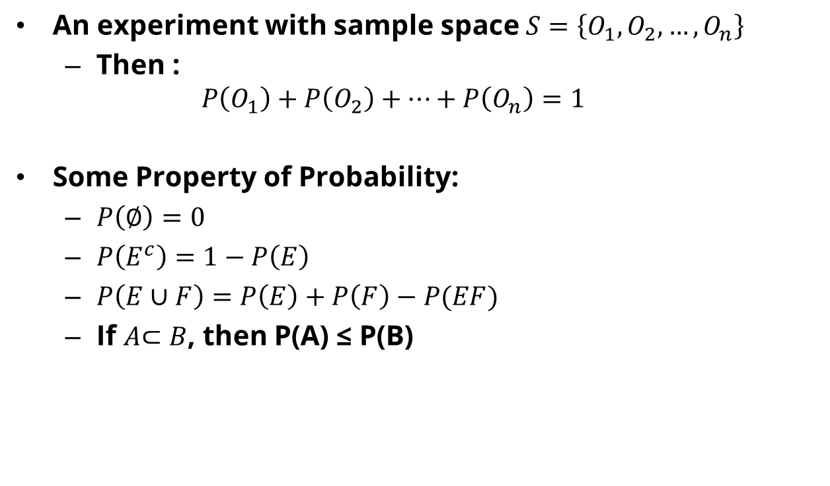
Axiom of Probability
An experiment with sample space $S=\left\{O_{1}, O_{2},…, O_{n}\right\}$
Then : $P\left(O_{1}\right)+P\left(O_{2}\right)+…+P\left(O_{n}\right)=1$
Some Property of Probability:
$P\left(∅\right)=0$
$P\left(E^{c}\right)=1−P\left(E\right)$
$P\left(E∪F\right)=P\left(E\right)+P\left(F\right)−P(EF)$
If $A$⊂ $B$, then P(A) ≤ P(B)

Slide 12

Example
The probability that a student passes math is 2/3 and the probability he/she passes biology is 4/9. The probability he/she passes both courses is 1/4.
How big is the probability he/she passes at least 1 course?
Answer:
M: the event the student passes math
B: the event the student passes biology

Slide 13
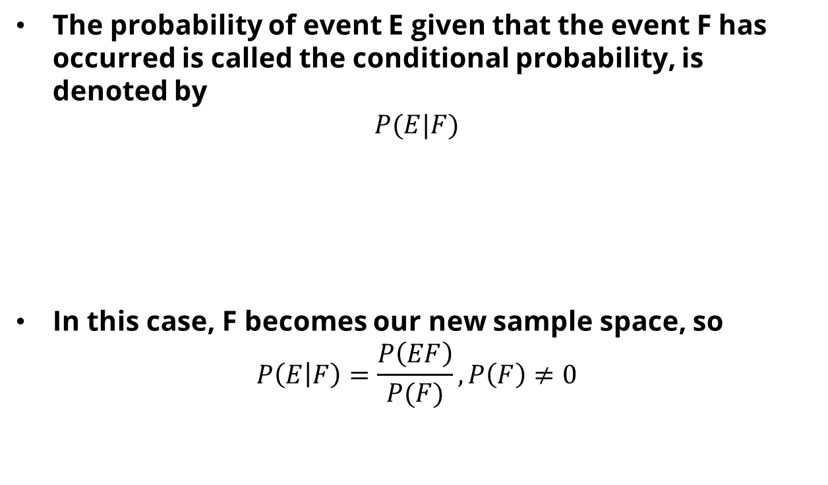
Conditional Probability
The probability of event E given that the event F has occurred is called the conditional probability, is denoted by
$$P(E|F)$$
In this case, F becomes our new sample space, so
$$P\left(E | F\right)=\frac{P\left(EF\right)}{P(F)}, P\left(F\right)≠0$$
P(E, given that event F already observed)

Slide 14

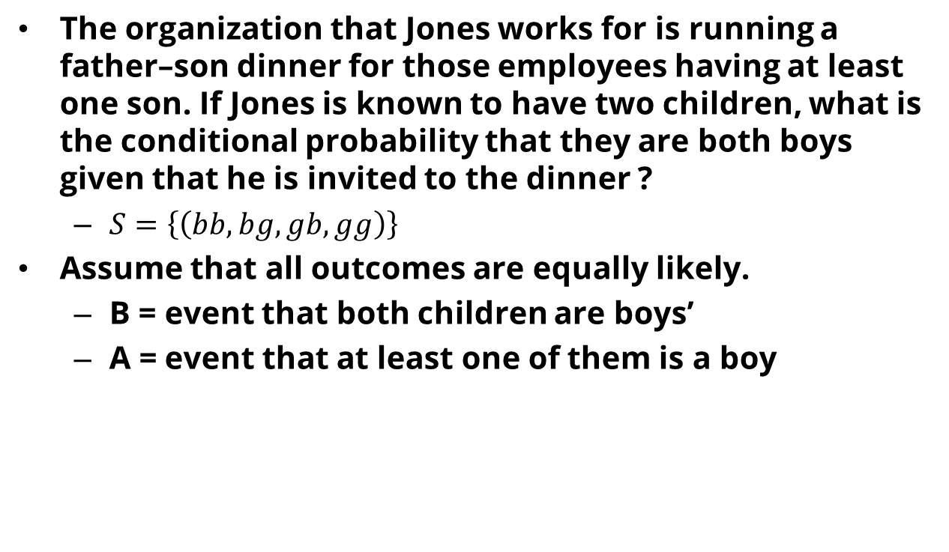
Example
The organization that Jones works for is running a father–son dinner for those employees having at least one son. If Jones is known to have two children, what is the conditional probability that they are both boys given that he is invited to the dinner ?
$S=\left\{\left(bb, bg, gb, gg\right)\right\}$
Assume that all outcomes are equally likely.
B = event that both children are boys’
A = event that at least one of them is a boy

Slide 15
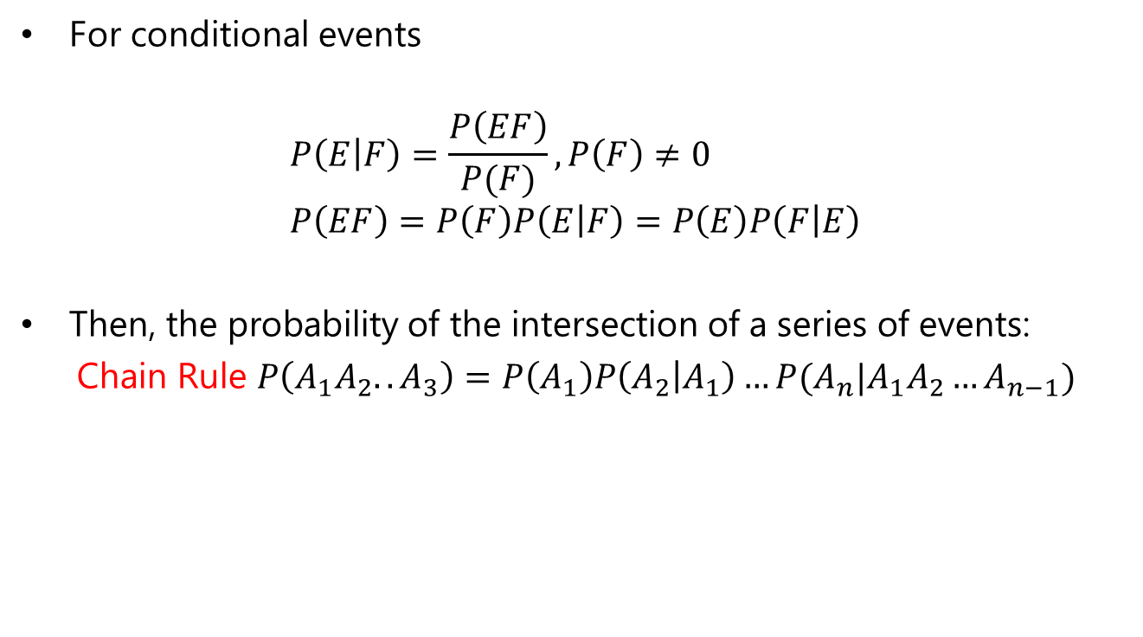
General Multiplication Rule
For conditional events
$$P\left(E | F\right)=\frac{P\left(EF\right)}{P(F)}, P\left(F\right)≠0 \\ P\left(EF\right)=P\left(F\right)P\left(E | F\right)=P\left(E\right)P\left(F | E\right)$$
Then, the probability of the intersection of a series of events:
Chain Rule $P\left(A_{1}A_{2}..A_{3}\right)=P\left(A_{1}\right)P\left(A_{2} | A_{1}\right)…P(A_{n}|A_{1}A_{2}…A_{n−1})$

Slide 16
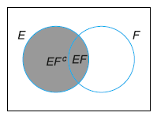
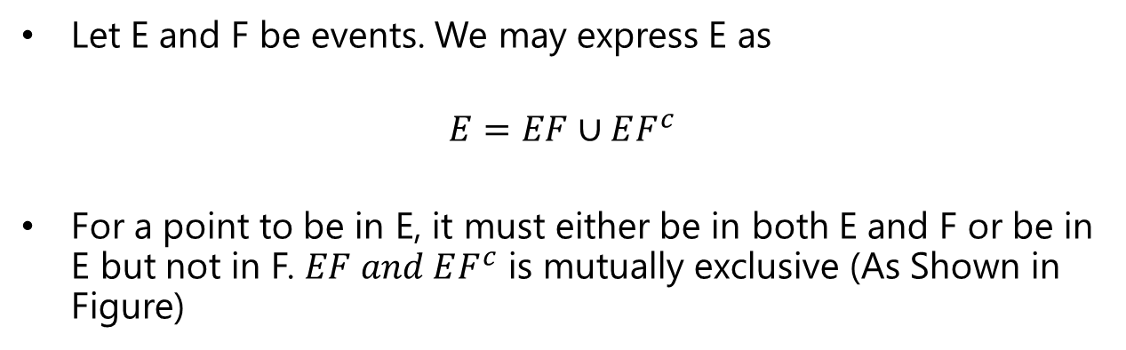
Bayes Rule
Let E and F be events. We may express E as
$$E=EF∪EF^{c}$$
For a point to be in E, it must either be in both E and F or be in E but not in F. $EF and EF^{c}$ is mutually exclusive (As Shown in Figure)

Slide 17
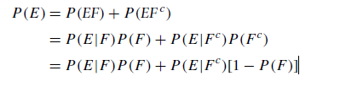
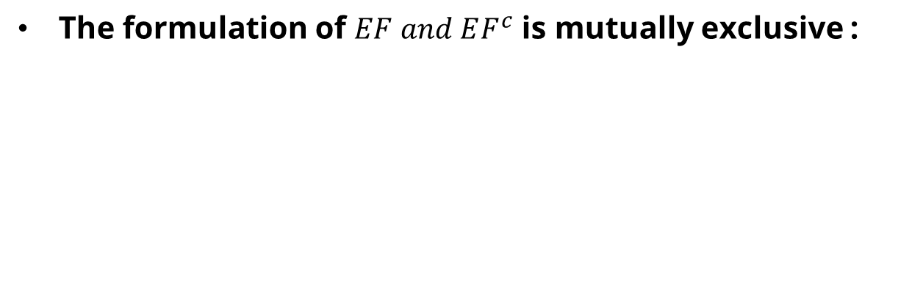
Bayes Rule
The formulation of $EF and EF^{c}$ is mutually exclusive :

Slide 18


Law of Total probability
Generalization of Previous Function:
$$S=C_{1}∪C_{2}∪…∪C_{n} \\ C_{i} is mutually exclusive \\ P\left(C_{i}\right)>0$$
Then, the following equations hold:

Slide 19

Bayes Theorem
$$P\left(A | B\right)=\frac{P\left(B | A\right)P\left(A\right)}{P(B)}$$
likelihood
Prior
Posterior
evidence

Slide 20
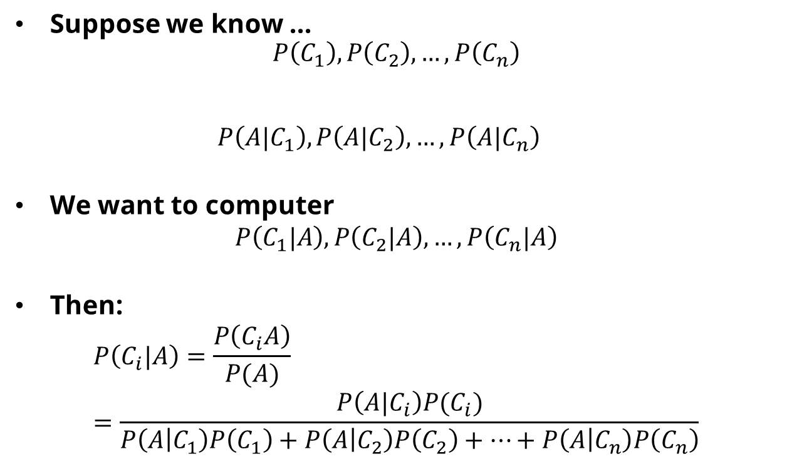
Bayes Theorem
Suppose we know ... $P\left(C_{1}\right), P\left(C_{2}\right),…, P\left(C_{n}\right)$ $P\left({A|C}_{1}\right), P\left({A|C}_{2}\right),…, P\left(A|C_{n}\right)$
We want to computer
$$P\left(C_{1}|A\right), P\left(C_{2}|A\right),…, P\left(C_{n}|A\right)$$
Then:
$$P\left(C_{i}|A\right)=\frac{P\left(C_{i}A\right)}{P(A)} \\ =\frac{P\left(A|C_{i}\right)P(C_{i})}{P\left(A | C_{1}\right)P\left(C_{1}\right)+P\left(A | C_{2}\right)P\left(C_{2}\right)+…+P\left(A | C_{n}\right)P\left(C_{n}\right)}$$
Prior probabilities
Likelihoods
Posterior probabilities

Slide 21
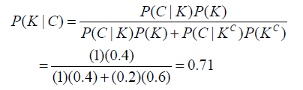
Example
On a multiple-choice test, the probability that a student knows the answer is 0.4. Assume that a student who guesses at the answer will be correct with probability 0.2. What is the conditional probability that a student knew the answer to a question given that he answered it correctly ?
C: events that the student answers correctly
K: events that the student knows the answer

Slide 22
Example
For example, a doctor knows that the disease meningitis causes the patient to have a stiff neck, say, 70% of the time
The doctor also knows some unconditional facts: the prior probability that a patient has meningitis is 1/50,000, and the prior probability that any patient has a stiff neck is 1%.

Slide 23
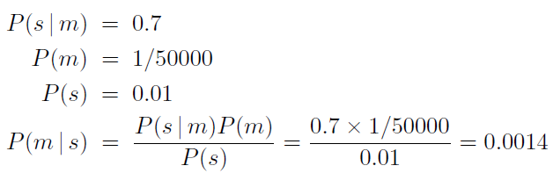
Example

Slide 24
Exercise

Slide 25
Problem 1
Marie is getting married tomorrow, at an outdoor ceremony in the desert. In recent years, it has rained only 5 days each year. Unfortunately, the weatherman has predicted rain for tomorrow. When it actually rains, the weatherman correctly forecasts rain 90% of the time. When it doesn't rain, he incorrectly forecasts rain 10% of the time. What is the probability that it will rain on the day of Marie's wedding?

Slide 26
Problem 2
Vany had onset of symptoms such as spots on the face. Doctor diagnose that Vany got chicken pox with the possibility:
Probability appearance of spots on the face, if Vany got chicken pox, p (spots/chicken pox) = 0,8
Probability Vany got chicken pox without notice any symptoms, p(chicken pox) = 0,4
Probability appearance of spots on the face, if Vany got allergy, p(spots/allergy) = 0,3
Probability Vany got allergy without notice any symptoms, p(allergy) = 0,7

Slide 27
References
Introduction to Probability and Statistics for Engineers & Scientists, 6th ed., Sheldon M. Ross, Elsevier, 2020.
Machine Intelligence, University of Waterloo, https://www.youtube.com/watch?v=uiPGPf2X8Co

